Slide 1
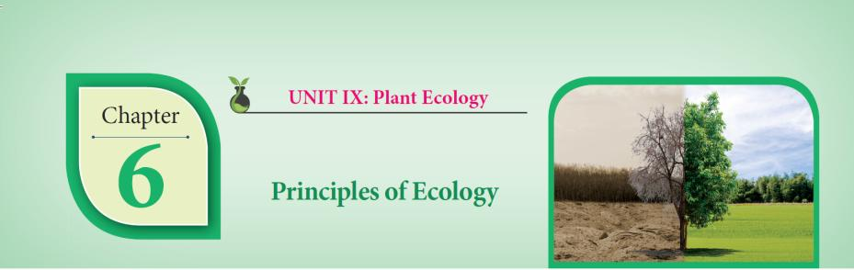
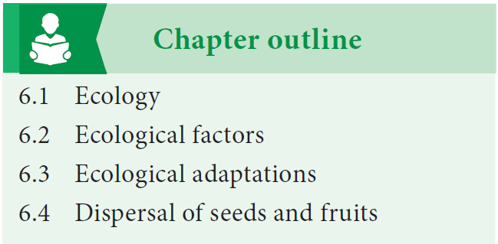

Slide 2
Details
Pages | 26
Diagrams | 53
Tables | 06
Do you know | 08
Flow Chart | 02
Info graphics | 02
Info box | 16
Book Back one mark questions | 21
Book back 2 ,3 & 5 marks questions | 35
NEET questions
Glossary
ICT corner
English-Tamil terminology
Reference books

Slide 3
Ecology
“Ecology” - oekologie is derived from two Greek words.
oikos - meaning house or dwelling place.
logos - meaning study.
first proposed by Reiter (1868).
widely accepted definition by Ernest Haeckel (1869).

Slide 4
Fathers of Ecology
Alexander vonHumboltFather of Ecology
Eugene P.Odum
Father ofmodrenEcology
RamdeoMisra
Father of Indian Ecology

Slide 5
Definitions of ecology
“The study of living organisms, both plants and animals, in their natural habitats or homes.”
- Reiter (1885)
“Ecology is the study of the reciprocal relationship between living organisms and their environment.”
- Earnest Haeckel (1889)

Slide 6
Ecological hierarchy
(Ecological levels of organization)
Individual organism
Population
Community
Ecosystem
Landscape
Biome
Biosphere

Slide 7
Branches of Ecology
1. Autecology(Species ecology) - Ecology of an individual species.
2. Synecology(Community ecology) - Ecology of a population.

Slide 8
Habitat and Niche
Habitat
  A specific physical place occupied by an organism.
  The environment of any community is called Biotope.
Niche
An organism’s place in the biotic environment and its functional role in an ecosystem.
Term by Roswell Hill Johnson.
Grinell (1917) use this term.
The habitat and niche of any organism is called Ecotope.

Slide 9
Ecological equivalents
Taxonomically different species occupying similar habitats (Niches) in different geographical regions
Example: Epiphytic orchids and Grasslands

Slide 10
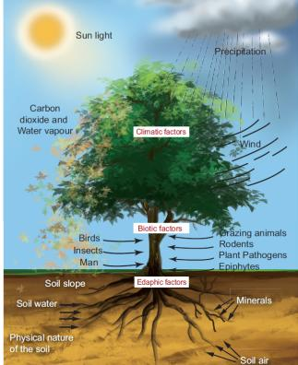
Ecological factors
Climatic factors
Edaphic factors
Topographic factors
Biotic factors

Slide 11
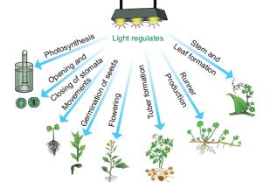
Climatic Factors
Light, Temperature, Water, Wind and Fire.
Light –
Effects on plants
Tolerance to intensities of light
1. Heliophytes
2. Sciophytes
visible part of light 400 nm (violet) to 700 nm (red)
Color | Wave length | Effects on photosynthesis
Blue | 400 -500 nm | Maximum
Red | 600 -700 nm | Maximum
Green | 500 -600 nm | Minimum

Slide 12
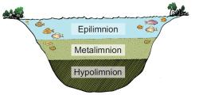
Temperature
Minimum temperature
Optimum temperature
Maximum temperature
Raunkiaer world’s vegetation - megatherms, mesotherms, microtherms and hekistotherms.
Thermal tolerance - Eurythermal ,Stenothermal
Thermal Stratification

Slide 13
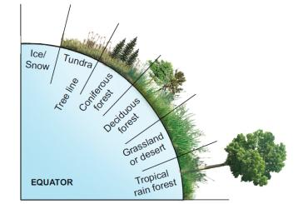
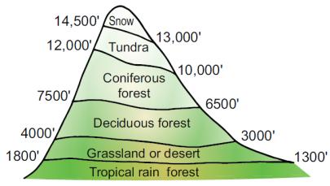
Temperature based zonation
Latitude Altitude
Timber line / Tree line - about 3000 to 4000m.
Effects of temperature

Slide 14
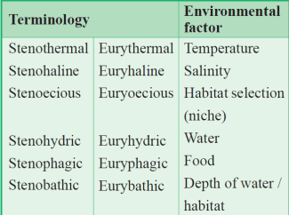
Water
Atmospheric moisture, Precipitation and Soil water.
Range of tolerance of salinity – Euryhaline, Stenohaline
Tolerance of Environmental factor
Phytoremediation.

Slide 15
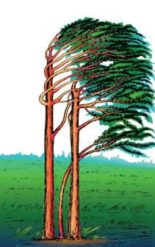
Wind
The composition of gases in atmosphere.
Green House Effect Albedo Effect.
Effects of wind.
Flag form in trees

Slide 16
Fire
Ground fire
Surface fire
Crown fire
Effects of fire
Indicators of fire - Fire break - Rhytidome

Slide 17
Edaphic factors
The soil
Soil formation
Soil types - Residual soils and Transported soils .
Edaphic factors which affect vegetation
  Soil moisture
  Soil water
  Soil reactions
  Soil nutrients
  Soil temperature
  Soil atmosphere
  Soil organisms

Slide 18
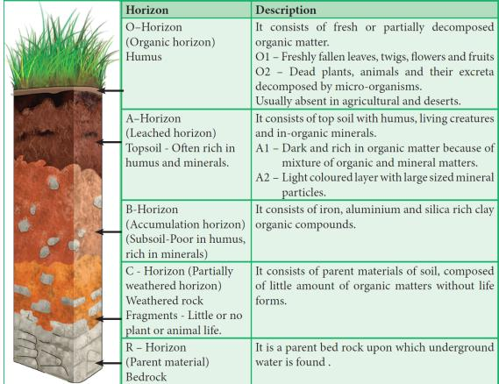
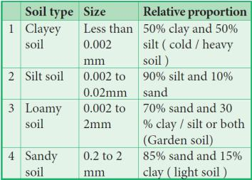
Soil Profile soil particles
Halophytes
Psammophytes
Lithophytes
Chasmophytes
Cryptophytes
Cryophytes
Oxylophytes
Calciphytes

Slide 19
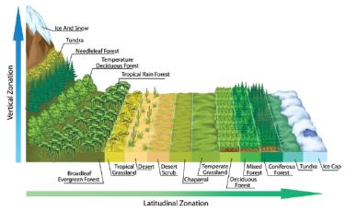
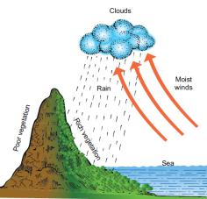
Topographic factors
surface features of earth
Latitudes and altitudes
Direction of Mountain
Steepness of the mountain
Latitudes and altitudes
Steepness of the mountain
Ecotone and Edge effect

Slide 20
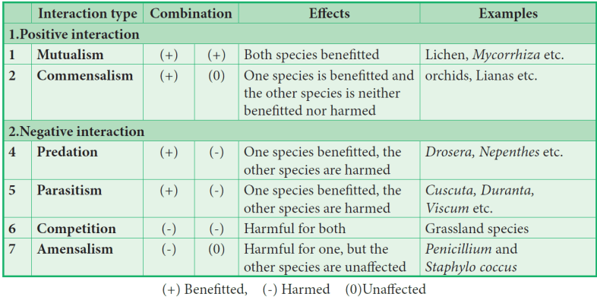
Biotic factors
interactions among living organisms

Slide 21
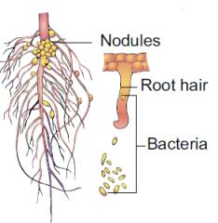
Mutualism
(+) (+)
Water fern (Azolla) and Nitrogen fixing Cyanobacterium (Anabaena ).
Anabaena present in coralloid roots of Cycas. (Gymnosperm)
Cyanobacterium (Nostoc) found in the thalloid body of Anthoceros.(Bryophytes)
Wasps present in fruits of fig.
Lichen is a mutual association of an alga and a fungus.
Roots of terrestrial plants and fungal hyphae- Mycorrhiza

Slide 22
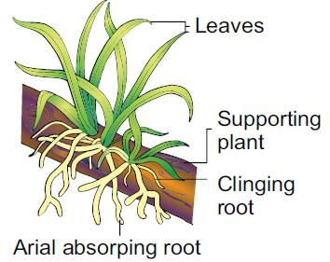
Commensalism
(+) (0)
        Epiphytes
An epiphytic plant-Vanda

Slide 23
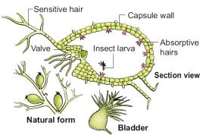
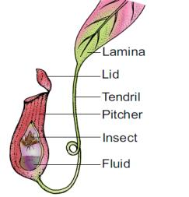
Predation
(+) (-)
Drosera (Sun dew Plant)
Nepenthes (Pitcher Plant)
Diaonaea (Venus fly trap)
Utricularia (Bladder wort)
Sarracenia

Slide 24
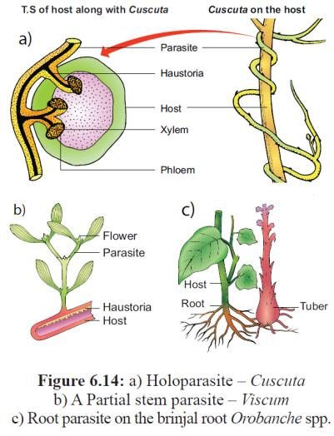
Parasitism
(+) (-)
Holoparasites (or) total parasites.
Hemiparasites (or) partial parasites.
Viscum and Loranthus are partial stem parasites.
Santalum (Sandal Wood) is a partial root parasite.

Slide 25
Competition
(-) (-)
Intraspecific competition
Interspecific competition

Slide 26
Amensalism
(-) (0)
Penicillium notatum (penicillin) inhibits the growth of Staphylococcus.
Trichoderma inhibits the growth of fungus Aspergillus.

Slide 27
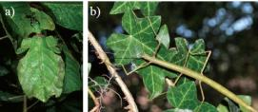
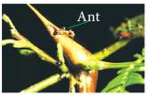
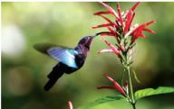
Interspecific interactions/ Co-evolutionary dynamics
Mimicry
floral mimicry - Ophrys an orchid
protective mimicry - Carausium morosus
                Myrmecophily
Co-evolution
a) Phyllium frondosum b) Carausium morosus

Slide 28
Ecological adaptations
Hydrophytes
Xerophytes
Mesophytes
Epiphytes
Halophytes

Slide 29
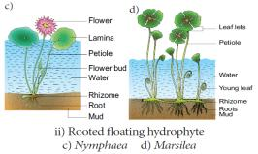
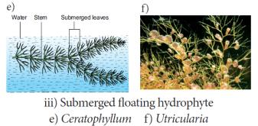
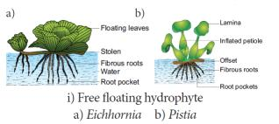
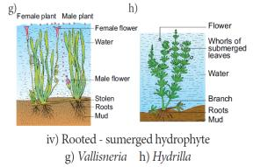
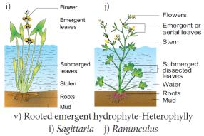
Hydrophytes
living in water or wet places

Slide 30
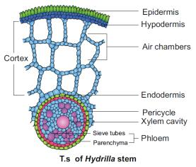
Morphological adaptations
Anatomical adaptations
Physiological adaptations

Slide 31
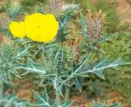
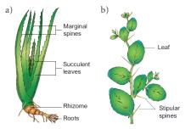
Xerophytes
Living in dry or xeric conditions
Physical dryness and Physiological dryness
Ephemerals, Succulents and Non succulent
Argemone mexicana
Aloe
Ziziphus

Slide 32
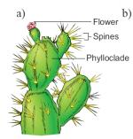
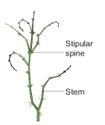
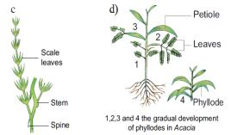
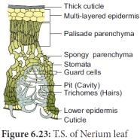
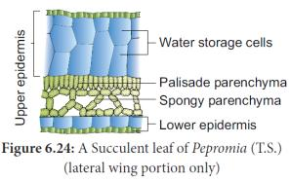
Morphological Adaptations
Anatomical adaptations
Physiological adaptations
Cladode - Asparagus
Phylloclade – opuntia
Phyllode – Acacia
Non succulent - Capparis

Slide 33
Mesophytes
living in moderate conditions
Morphological Adaptations
Anatomical adaptations
Physiological adaptations

Slide 34
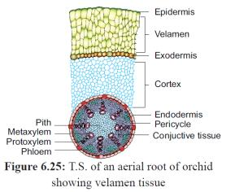
Epiphytes
Grow perched on other plants
Morphological Adaptations
Anatomical adaptations
Physiological adaptations

Slide 35
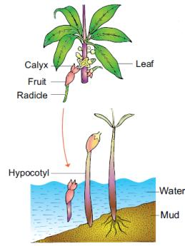
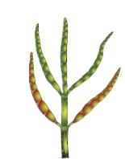
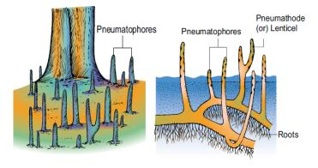
Halophytes
Morphological Adaptations
Anatomical adaptations
Physiological adaptations
Succulent halophyte - Salicornia
Pneumatophores of mangrove plant
Vivipary germination

Slide 36
Dispersal of Fruits and Seeds
dissemination of seeds and fruits to various distances
Dispersal by Wind (Anemochory)
Dispersal by Water (Hydrochory)
Dispersal by Animals (Zoochory)
Dispersal by Explosive Mechanism (Autochory)

Slide 37
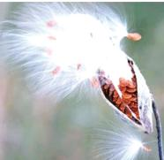
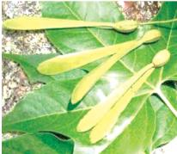
Dispersal by Wind (Anemochory)
Adaptation
  Minute seeds - Orchids.
  Wings - Maple, Gyrocarpus, Dipterocarpus and Terminalia
  Feathery Appendages - Vernonia and Asclepias.
  Censor mechanisms - Aristolochia and Poppy.
Asclepias
Gyrocarpus

Slide 38
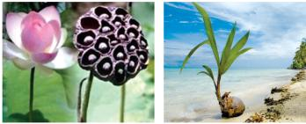
Dispersal by Water (Hydrochory)
Obconical receptacle with prominent air spaces – Nelumbo.
Fibrous mesocarp - Coconut.
Seeds are light, small with aril – Nymphaea.
Fruits inflated - Heritiera littoralis.
Carried by water current - Coconut.
Nelumbo
Coconut

Slide 39
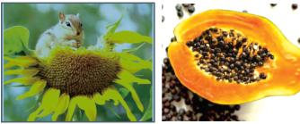
Dispersal by Animals (Zoochory)
Hooked fruits - hooks,(Xanthium), barbs (Andropogon), spines (Aristida).
Sticky fruits and seeds
  Sticky glandular hairs - Boerhaavia and Cleome.
  Viscid layer - Cordia and Alangium.
Fleshy fruits - Mango and Diplocyclos
Sunflower
Papaya

Slide 40
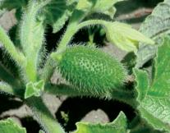
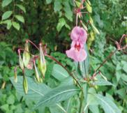
Dispersal by Explosive Mechanism (Autochory)
Great force - Impatiens (Balsam), Hura.
Burst suddenly with a noise - Ruellia and Crossandra.
Explode with a loud noise - Bauhinia vahlii (Camel’s foot climber).
High turgor pressure develops insid e the fruit - Ecballium elatrium (Squirting cucumber) Gyrocarpus and Dipterocarpus.
Ecballium elatrium
Impatiens

Slide 41
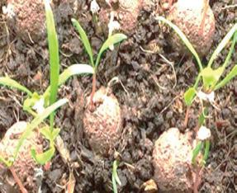
Human aided seed dispersal
Seed Ball
Advantages of seed dispersal

Slide 42
THANK YOU

